Slide 1


Craftive App: The creative Craftsman
– IPP Final Presentation
Fantastic Trio: Lisa Weinmann, Jiexiang Shu, Runcong Chen
Technische Universität München
Munich, 09.02.2022
Source: Mann Für Mit Tools Stockfoto und mehr Bilder von Handwerker - iStock (istockphoto.com)

Slide 2
IDEA
RESEARCH AND INTERVIEW
USER ANALYSIS
Idea
Static web prototype
- 24.11.21
- 19.01.22
Quantitative
evaluation
- 10.11.21
- 15.12.21
Happy New Year!
Paper Prototype
Dynamic web prototype
Lisa Weinmann, Jiexiang Shu, Runcong Chen| Fantastic Trio | Craftive App | 09.02.22

Slide 3

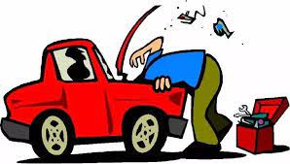
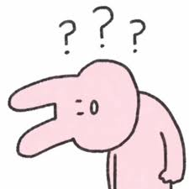


IDEA
RESEARCH AND INTERVIEW
USER ANALYSIS
Craftive=creative + craft
Target: Find other users to solve the craft problems and get inspirations for craft projects and tipps from other users
Lisa Weinmann, Jiexiang Shu, Runcong Chen| Fantastic Trio | Craftive App | 09.02.22

Slide 4

IDEA
RESEARCH AND INTERVIEW
USER ANALYSIS
Method: Expert interview
Preparing interview:
Participants: 6
Identify: Students, Employees, Retired
Nationality: Germany, China
Content: Demands, Functions, Concerns(14 Items)
Results: Get good feedback and inspirations to the work of prototype
Source: business-interview-illustration-vector-id977762310 (612×612) (istockphoto.com)
Lisa Weinmann, Jiexiang Shu, Runcong Chen| Fantastic Trio | Craftive App | 09.02.22

Slide 5
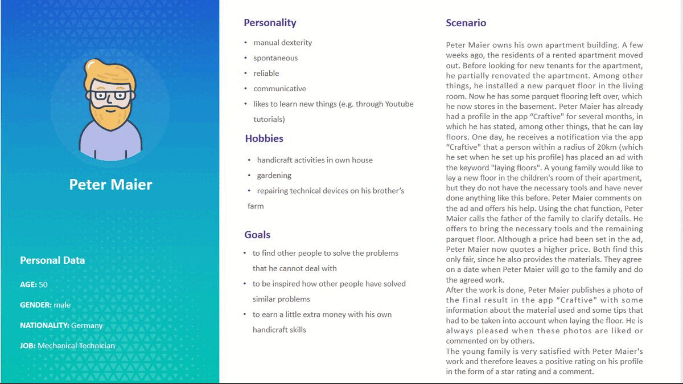
IDEA
RESEARCH AND INTERVIEW
USER ANALYSIS
Method: Personas and Scenarios
Number: 3
Content:
Personality
Hobby
Goal
Use Scenes
Lisa Weinmann, Jiexiang Shu, Runcong Chen| Fantastic Trio | Craftive App | 09.02.22

Slide 6
EVALUATION-1
HIFI PROTOTYPE
EVALUATION-2
LOFI PROTOTYPE
HIFI PROTOTYPE
Idea
Static web prototype
- 24.11.21
- 19.01.22
Quantitative
evaluation
- 10.11.21
- 15.12.21
Happy New Year!
Paper prototype
Dynamic web prototype
Lisa Weinmann, Jiexiang Shu, Runcong Chen| Fantastic Trio | Craftive App | 09.02.22

Slide 7
EVALUATION-1
EVALUATION-2
LOFI PROTOTYPE
HIFI PROTOTYPE
Hardware:
iPad
Apple Pencil
Software:
Notability
PowerPoint
Functions
Release requests
Explore page (check projects/comment/like)
Notifications/contact/payment
Check suitable providers’ profiles
Lisa Weinmann, Jiexiang Shu, Runcong Chen| Fantastic Trio | Craftive App | 09.02.22

Slide 8

EVALUATION-1
EVALUATION-2
LOFI PROTOTYPE
HIFI PROTOTYPE
Method: Thinking aloud experiment
Preparing experiment:
Participants: 3
Identify: Students, Employees
Nationality: Germany
Goals: Know the user experience of the App and find improvements
Source: https://chuniversiteit.nl/images/optimised/2018/usability-test-of-a-familiar-looking-website/2176.webp
Lisa Weinmann, Jiexiang Shu, Runcong Chen| Fantastic Trio | Craftive App | 09.02.22

Slide 9

EVALUATION-1
EVALUATION-2
LOFI PROTOTYPE
HIFI PROTOTYPE
Needed improvements:
Confusing names of button
Too many input boxes
Without a subdivision for “notification box”
Complex rating system
Source: https://encrypted-tbn0.gstatic.com/images?q=tbn:ANd9GcTYD96RXboMKtS3RaUs7R33BgDb7XGE5Fc6Ag&usqp=CAU
Lisa Weinmann, Jiexiang Shu, Runcong Chen| Fantastic Trio | Craftive App | 09.02.22

Slide 10
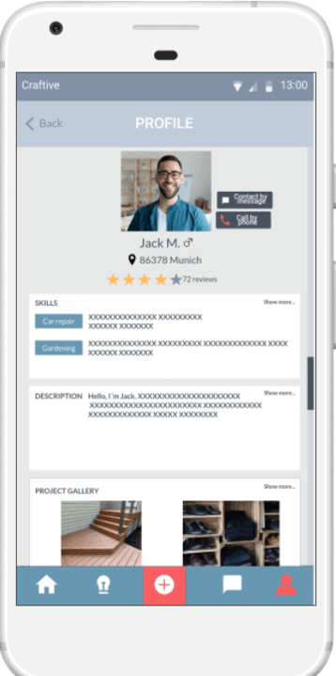
EVALUATION-1
EVALUATION-2
LOFI PROTOTYPE
HIFI PROTOTYPE
Hardware:
Laptop
Software:
Marvel
Key points of HIFI prototype:
Aesthetics
Interaction logic
…
Lisa Weinmann, Jiexiang Shu, Runcong Chen| Fantastic Trio | Craftive App | 09.02.22

Slide 11
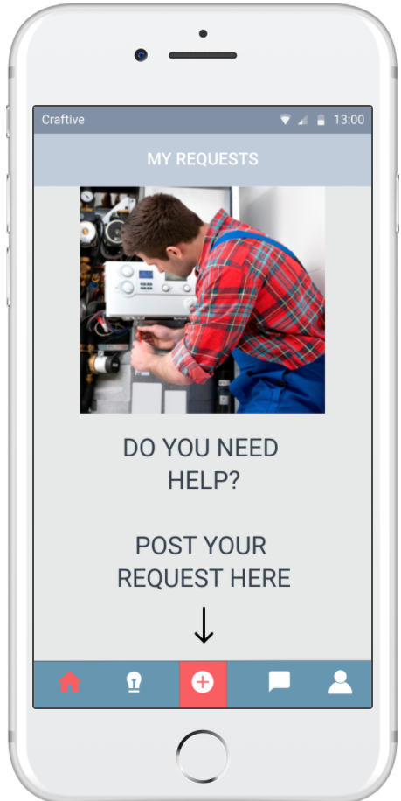
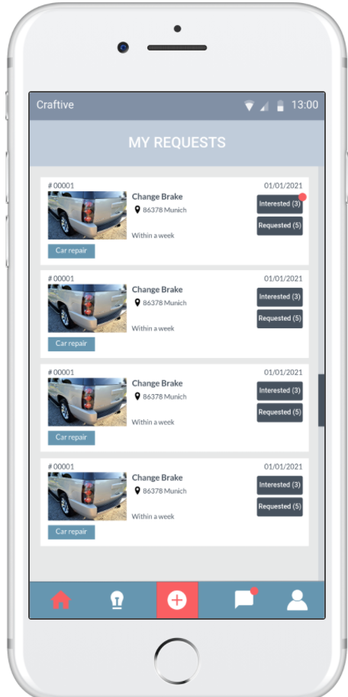
EVALUATION-1
EVALUATION-2
LOFI PROTOTYPE
HIFI PROTOTYPE
Lofi prototype
Hifi prototype
Lofi prototype
Hifi prototype
Lisa Weinmann, Jiexiang Shu, Runcong Chen| Fantastic Trio | Craftive App | 09.02.22

Slide 12

EVALUATION-1
HIFI PROTOTYPE
LOFI PROTOTYPE
EVALUATION-2
Method: Heuristic usability evaluation
From：Our partner team
Need to improvements:
Red/blue contrast
Missing the name of App
Unfavorable font size in some places
Source:https://www.akademische-gesellschaft.com/en/research/topics/agility/step-5-evaluation/
Lisa Weinmann, Jiexiang Shu, Runcong Chen| Fantastic Trio | Craftive App | 09.02.22

Slide 13
REFLECTIONS
QUALITATIVE EVALUATION
Idea
Static web prototype
- 24.11.21
- 19.01.22
Quantitative
evaluation
- 10.11.21
- 15.12.21
Happy New Year!
Paper prototype
Dynamic web prototype
Lisa Weinmann, Jiexiang Shu, Runcong Chen| Fantastic Trio | Craftive App | 09.02.22

Slide 14
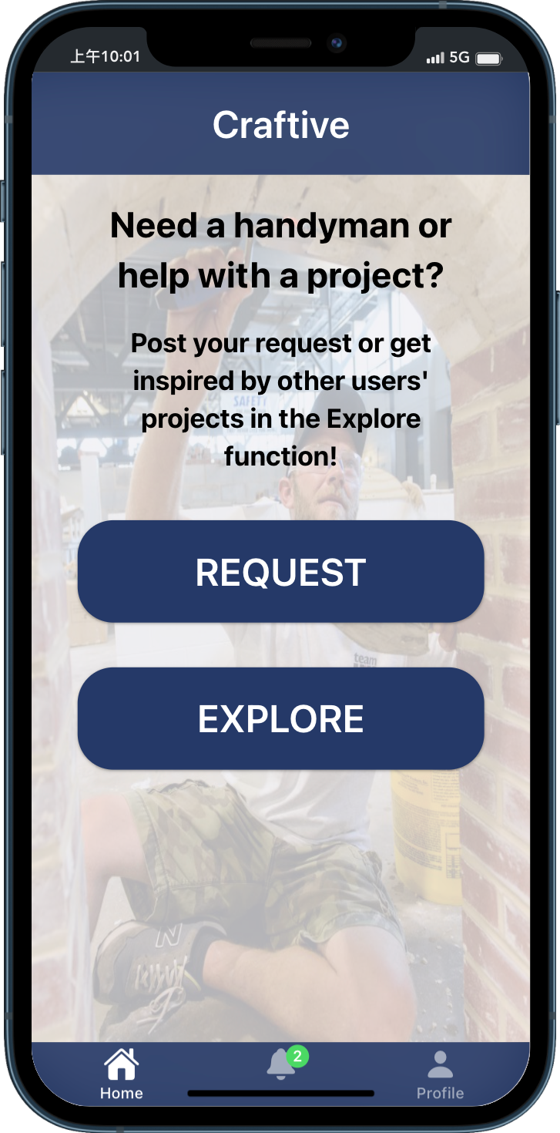
REFLECTIONS
QUALITATIVE EVALUATION
Improvements:
Add App name in homepage
Change theme colors to increase contrast
Background color:
Badge color:
Choose appropriate font size: >10pt²
Redesign:
Redesign Homepage
1
3
11.12:1 > 3:1¹
6.04:1 > 3:1
2
Hifi paper prototype
Static web prototype
Lisa Weinmann, Jiexiang Shu, Runcong Chen| Fantastic Trio | Craftive App | 09.02.22

Slide 15
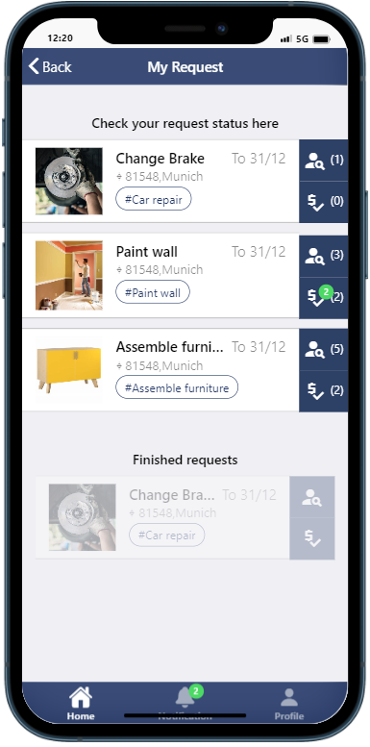
REFLECTIONS
QUALITATIVE EVALUATION
Hifi paper prototype
Static web prototype
Hifi paper prototype
Static web prototype
Lisa Weinmann, Jiexiang Shu, Runcong Chen| Fantastic Trio | Craftive App | 09.02.22

Slide 16
REFLECTIONS
QUALITATIVE EVALUATION*
1/3. Unclear hompage design
Check
Request
Request
Add
Request
Find
Helpers
Check
Helpers
Contact
Helpers
Payment
Explore
Explore
Page
Project
Helper‘s
Profile
* [3 test subjects aged 27-60 (Ø 47,3 years)]
Homepage
Lisa Weinmann, Jiexiang Shu, Runcong Chen| Fantastic Trio | Craftive App | 09.02.22

Slide 17
REFLECTIONS
QUALITATIVE EVALUATION*
1/3. Unclear hompage design
Check
Request
Request
Add
Request
Find
Helpers
Check
Helpers
Contact
Helpers
Payment
Explore
Explore
Page
Project
Helper‘s
Profile
* [3 test subjects aged 27-60 (Ø 47,3 years)]
Homepage
Lisa Weinmann, Jiexiang Shu, Runcong Chen| Fantastic Trio | Craftive App | 09.02.22

Slide 18
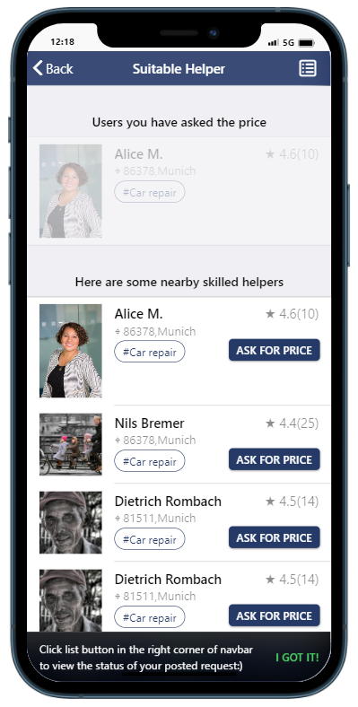
REFLECTIONS
QUALITATIVE EVALUATION*
2/3. Complex and confusing user process
Check
Request
Request
Add
Request
Find
Helpers
Check
Helpers
Contact
Helpers
Payment
Explore
Explore
Page
Project
Helper‘s
Profile
* [3 test subjects aged 27-60 (Ø 47,3 years)]
Find Helpers
Lisa Weinmann, Jiexiang Shu, Runcong Chen| Fantastic Trio | Craftive App | 09.02.22

Slide 19
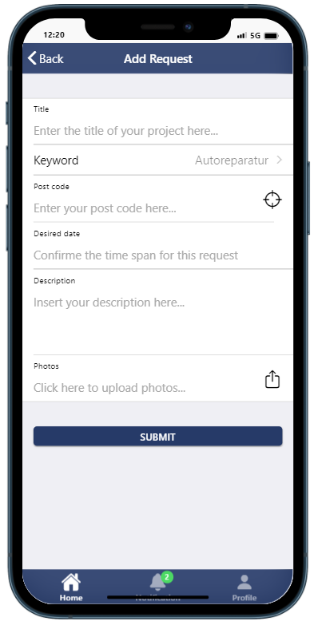
REFLECTIONS
QUALITATIVE EVALUATION*
3/3. Old fashioned style
Homepage
Add request
Find helpers
Check request
Lisa Weinmann, Jiexiang Shu, Runcong Chen| Fantastic Trio | Craftive App | 09.02.22

Slide 20

REFLECTIONS
DYNAMIC WEB PROTOTYPE
Idea
Static web prototype
- 24.11.21
- 19.01.22
Quantitative Evaluation
- 10.11.21
- 15.12.21
Happy New Year!
Paper prototype
Dynamic web prototype
Lisa Weinmann, Jiexiang Shu, Runcong Chen| Fantastic Trio | Craftive App | 09.02.22

Slide 21
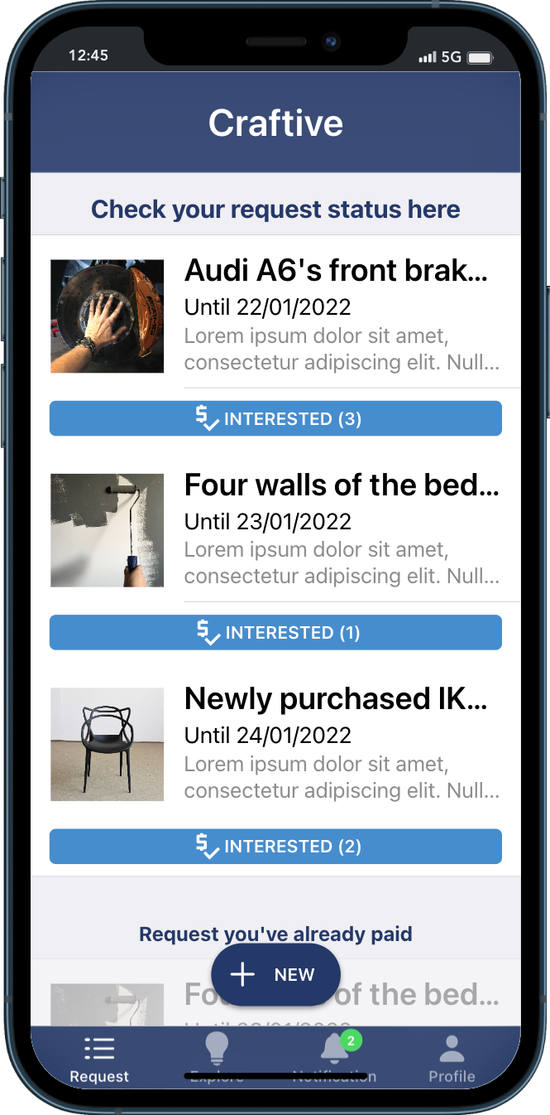
REFLECTIONS
DYNAMIC WEB PROTOTYPE
Redesign Homepage and User flow
Check
Request
Check
Helpers
Add
Request
Contact
Helpers
Payment
Explore
Page
Project
Helper‘s
Profile
Homepage
Lisa Weinmann, Jiexiang Shu, Runcong Chen| Fantastic Trio | Craftive App | 09.02.22

Slide 22
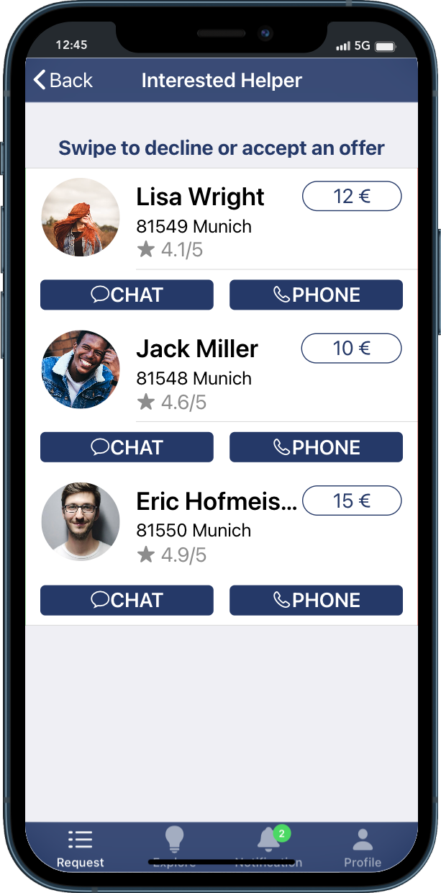
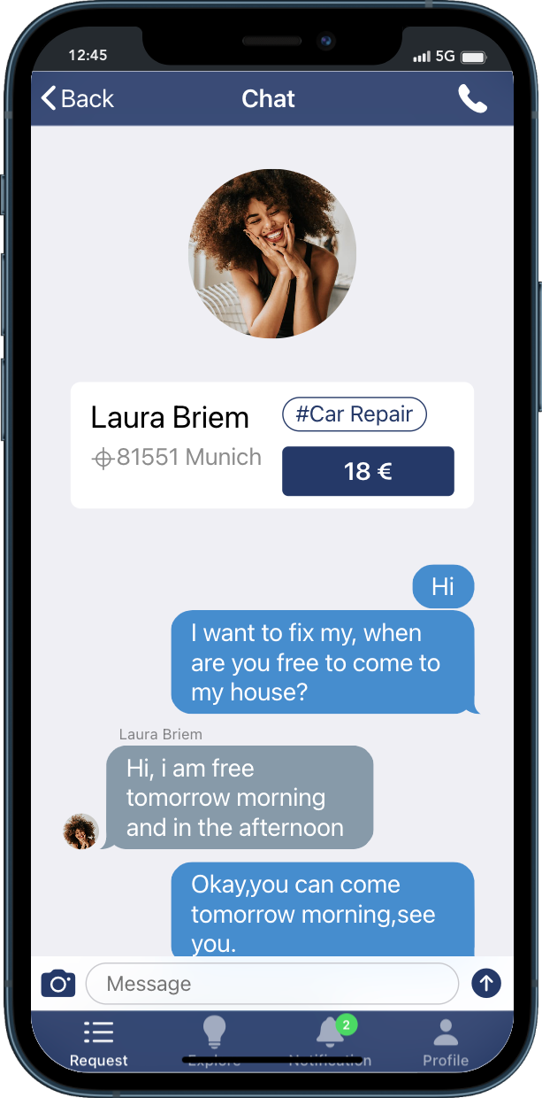
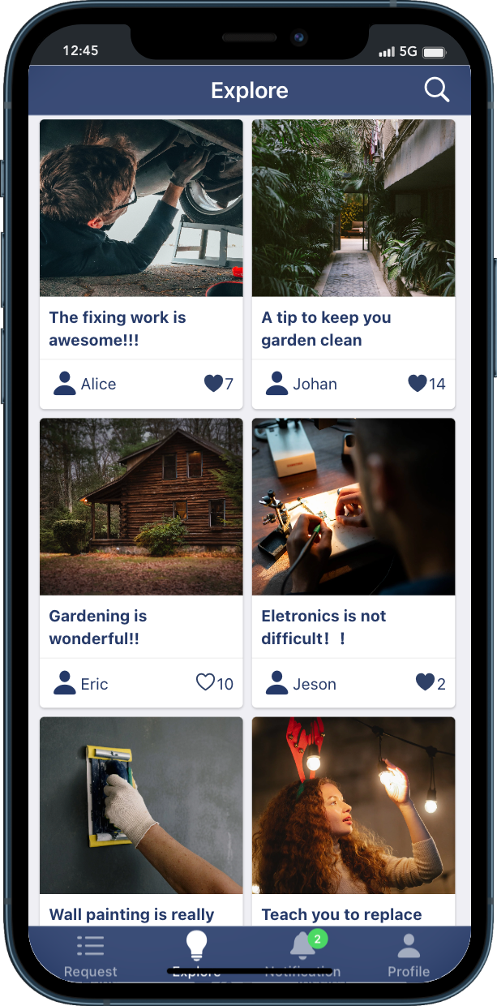
REFLECTIONS
DYNAMIC WEB PROTOTYPE
Redesign App style
Homepage
Check helpers
Chat page
Explore page
Lisa Weinmann, Jiexiang Shu, Runcong Chen| Fantastic Trio | Craftive App | 09.02.22

Slide 23
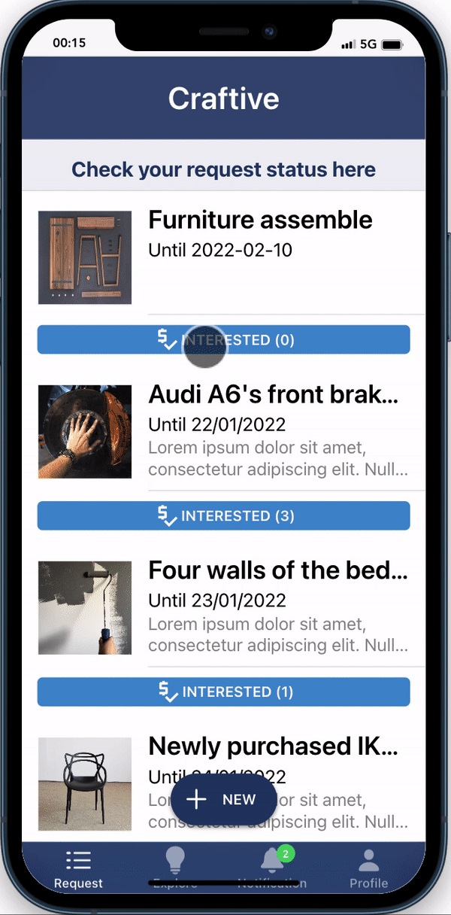
REFLECTIONS
DYNAMIC WEB PROTOTYPE
Get information for the data elements dynamically
Link the data elements to functional elements
Implement the interaction
Homepage
Lisa Weinmann, Jiexiang Shu, Runcong Chen| Fantastic Trio | Craftive App | 09.02.22

Slide 24
DEMONSTRATION OF PROTOTYPE
QUANTITATIVE EVALUATION
Idea
Static web prototype
- 24.11.21
- 19.01.22
Quantitative Evaluation
- 10.11.21
- 15.12.21
Happy New Year!
Paper Prototype
Dynamic web Prototype
Lisa Weinmann, Jiexiang Shu, Runcong Chen| Fantastic Trio | Craftive App | 09.02.22

Slide 25
DEMONSTRATION OF PROTOTYPE
QUANTITATIVE EVALUATION
Link to the web prototype:
​ https://interactionprototyping.github.io/WS2022_FantasticTrio/
Homepage
Lisa Weinmann, Jiexiang Shu, Runcong Chen| Fantastic Trio | Craftive App | 09.02.22

Slide 26


DEMONSTRATION OF PROTOTYPE
QUANTITATIVE EVALUATION
19 Hypothesis were tested, 10 test subjects aged 24-76 (Ø 43,6 years)
1. Learnability
2. Effectiveness
3. Efficiency
4. Memorability
5. Errors ( ) 6. Satisfaction³
"80% of the test users were faster in creating the second request in
comparison to the first"​
"Only 10% of the test users made a mistake while commenting another users´ project"
Lisa Weinmann, Jiexiang Shu, Runcong Chen| Fantastic Trio | Craftive App | 09.02.22

Slide 27
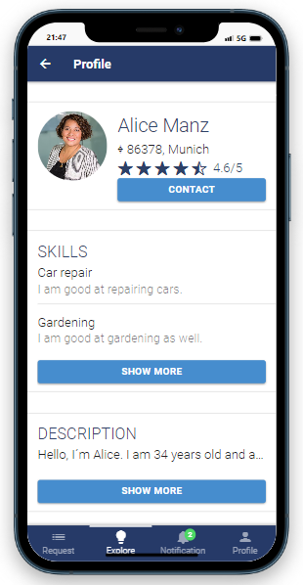
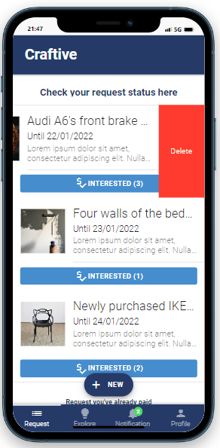
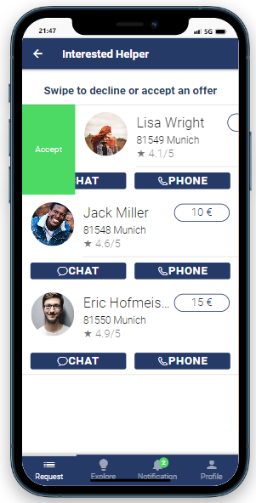
DEMONSTRATION OF PROTOTYPE
QUANTITATIVE EVALUATION
Access to profile rating details
Delete a request
Decline or accept an offer
70% < 78% ⁴
60% < 78%
70% < 78%
Lisa Weinmann, Jiexiang Shu, Runcong Chen| Fantastic Trio | Craftive App | 09.02.22

Slide 28
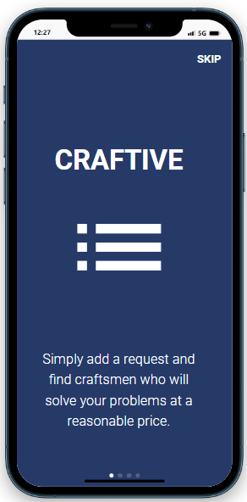
SUMMARY
SUS-Score of 70.75 out of 100
on average
Lisa Weinmann, Jiexiang Shu, Runcong Chen| Fantastic Trio | Craftive App | 09.02.22

Slide 29
REFERENCES
[1] ISO 9241-303:2008 Ergonomics of human-system interaction — Part 303: Requirements for electronic visual displays
[2] Fitts, P. M. (1954). The information capacity of the human motor system in controlling the amplitude of movement. Journal of Experimental Psychology, 47(6), 381–391. https://doi.org/10.1037/h0055392
[3] Nielsen, Jakob (1993). Usability Engineering || What Is Usability?., (), 23–48. doi:10.1016/b978-0-08- 052029-2.50005-x (Retrieved on 14.01.2022)
[4] J. R. Lewis, „The System Usability Scale: Past, Present, and Future,“ International Journal of Human–Computer Interaction, p. 1–14, 2018.
Lisa Weinmann, Jiexiang Shu, Runcong Chen| Fantastic Trio | Craftive App | 09.02.22

Slide 30
THANK YOU!
And looking forward to your FEEDBACK!
Lisa Weinmann, Jiexiang Shu, Runcong Chen| Fantastic Trio | Craftive App | 09.02.22

